Slide 1

High Cloud Airlines
Elevating journeys with innovation, efficiency, and
unmatched care—where every flight takes you closer to the future

Slide 2
Our Teammates
Vishal Kumar
Ishita Solanki
Atharva Pawar
Anita Shinde
Vaishnavi Kongale
Ashwin Patidar
Spandan Somwanshi

Slide 3
Agenda
Introduction
Objective
Business Overview
Project Scope
Data Model challenges
Dashboards
Recommendation & Conclusion

Slide 4
Introduction
The High Cloud Airline project focuses on revolutionizing the airline industry by leveraging advanced technology and customer-centric solutions.
The project aims to enhance operational efficiency, optimize resource management, and elevate the travel experience for passengers.
Through innovative tools like real-time data analysis, streamlined booking systems, and enhanced customer support, High Cloud Airline aspires to set new benchmarks in safety, convenience, and sustainability.
This initiative underscores a commitment to excellence, making air travel more seamless and accessible for everyone

Slide 5
Objective
To gain a comprehensive understanding of “High Cloud Airlines” operations through data analysis.
This will involve investigating load factors, identifying top carrier names based on passenger preference, analyzing popular routes, and exploring other key metrics.
The ultimate goal is to provide actionable recommendations that can enhance operational efficiency and Profitability .

Slide 6
Business Overview
High Cloud Airline is a forward-thinking aviation company leveraging data-driven insights to enhance operations and customer satisfaction. Our approach combines real time data analysis with advanced technologies to optimize fleet management, improve route efficiency, and elevate passenger experiences.
Improved load factor
Enhance Passenger Experience
Optimized resource allocation
Data –Driven Decision Making

Slide 7
Project Scope
This project aims to harness data analysis to optimize High Cloud Airline's operations and performance by focusing on key performance indicators (KPIs). The scope includes in depth analysis of the following:
Load Factors
Passenger Preferences
Popular Routes
Operational Efficiency

Slide 8
Data Modelling
Throughout our analysis, we encountered various challenges in handling the data. Overcoming these challenges is crucial for accurate insights.
Data Volume: Managing and Processing large datasets efficiently.
Data Quality: Ensuring accuracy and reliability of the data.
Complex Relationships: Establishing connections between different data points.

Slide 9
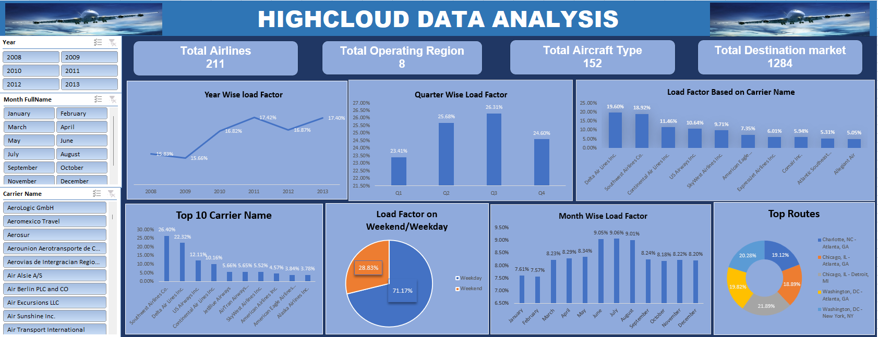
EXCEL DASHBOARD

Slide 10
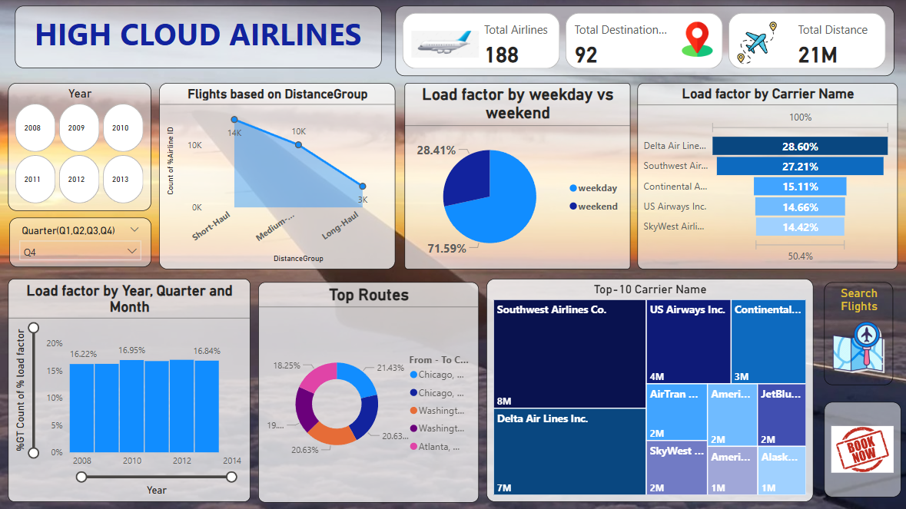
POWER BI DASHBOARD

Slide 11
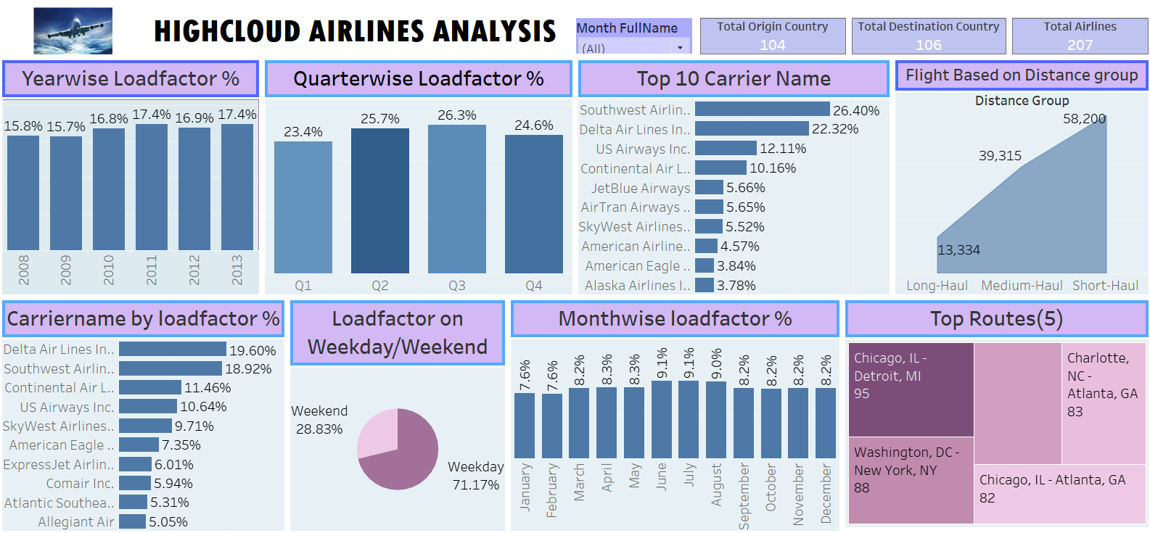
TABLEAU DASHBOARD

Slide 12
SQL QUERIES

Slide 13
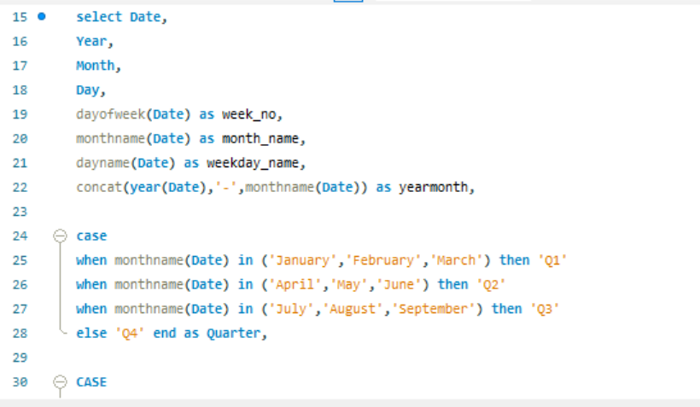
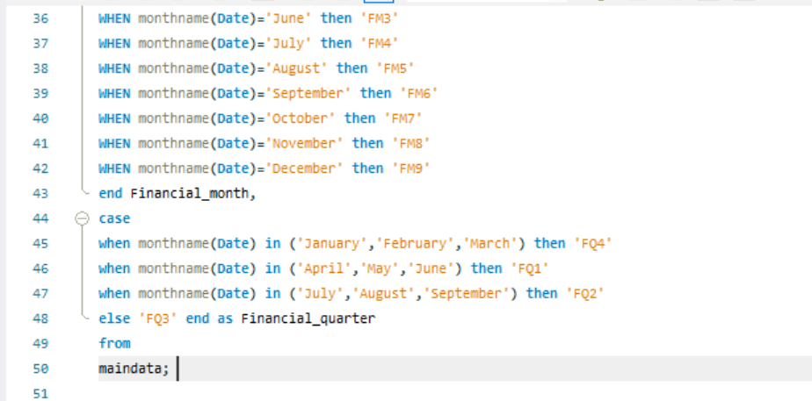
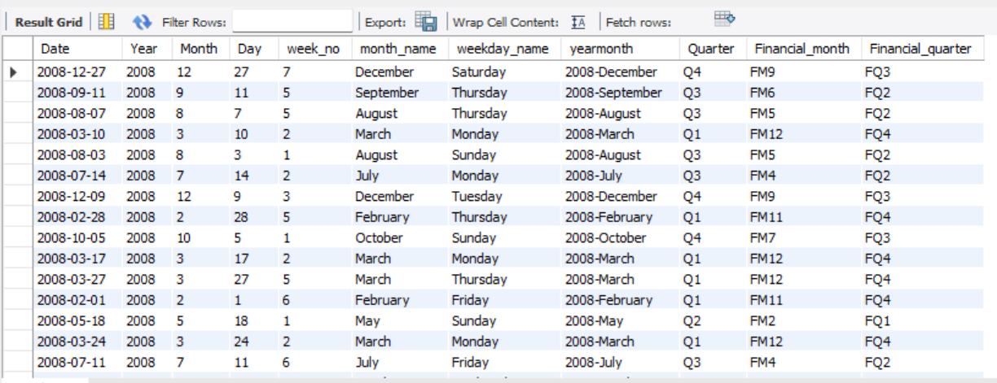
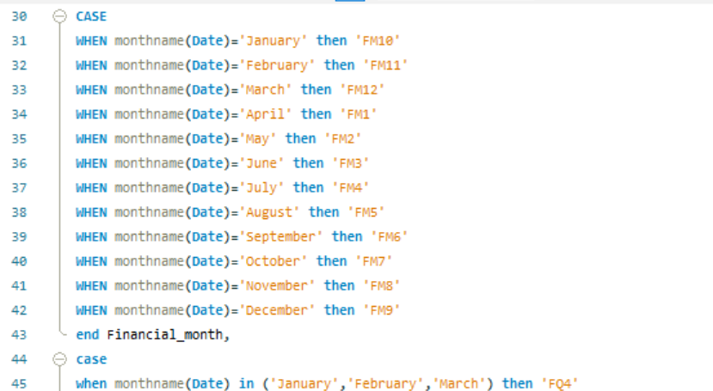

Slide 14
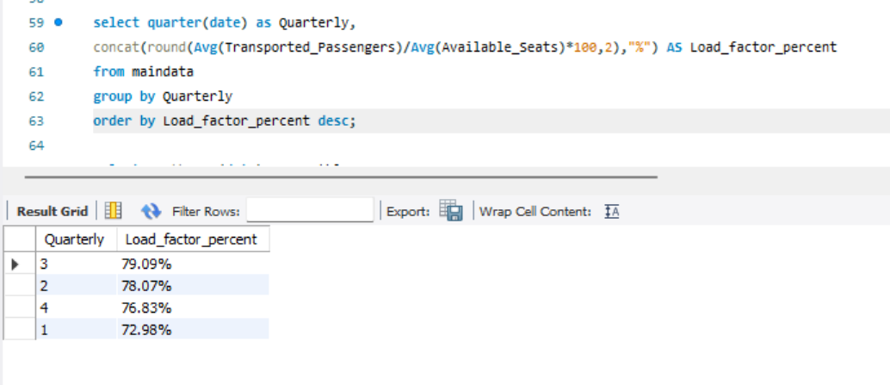
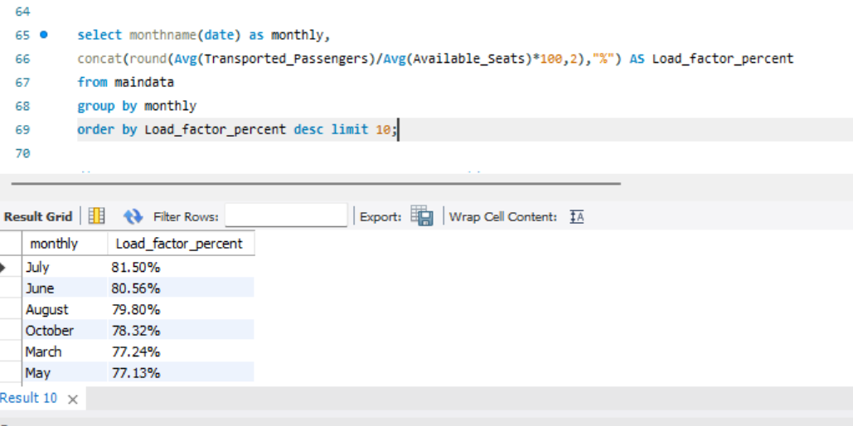
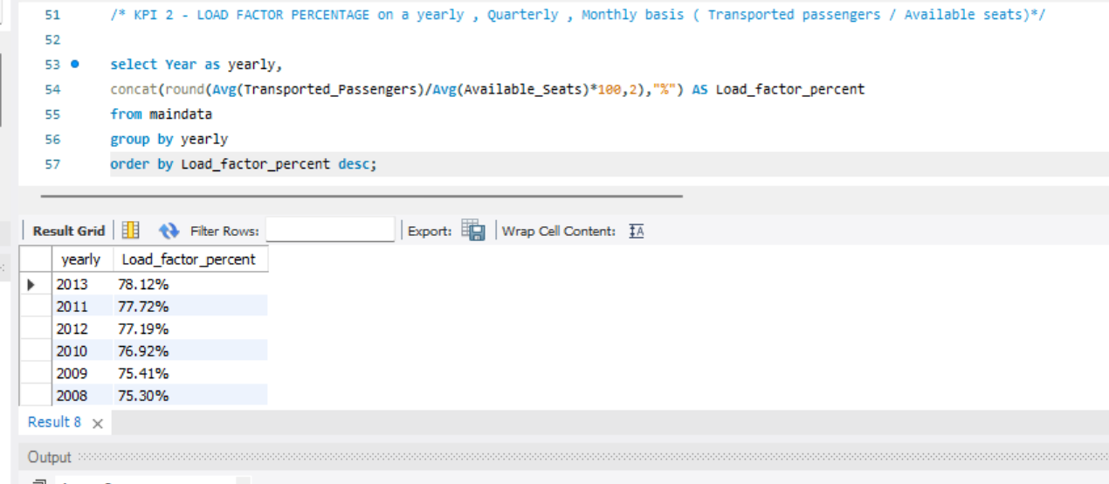

Slide 15
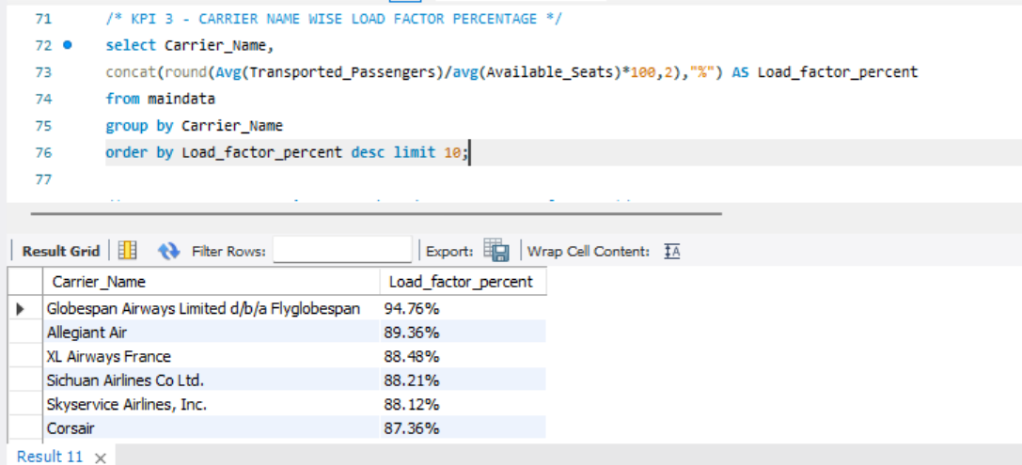
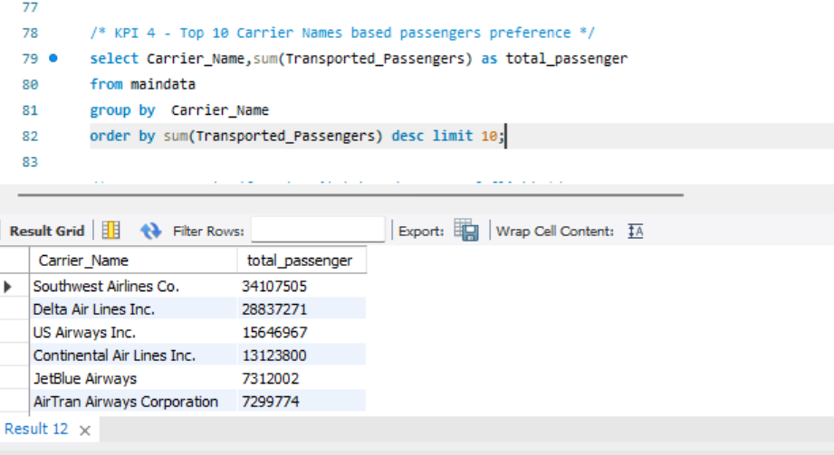

Slide 16
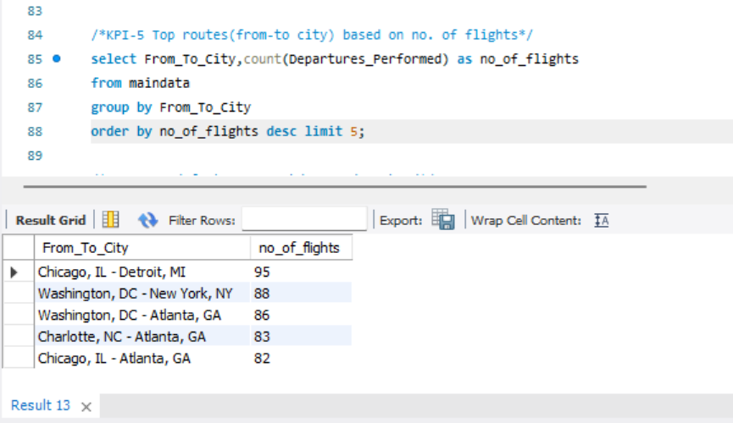
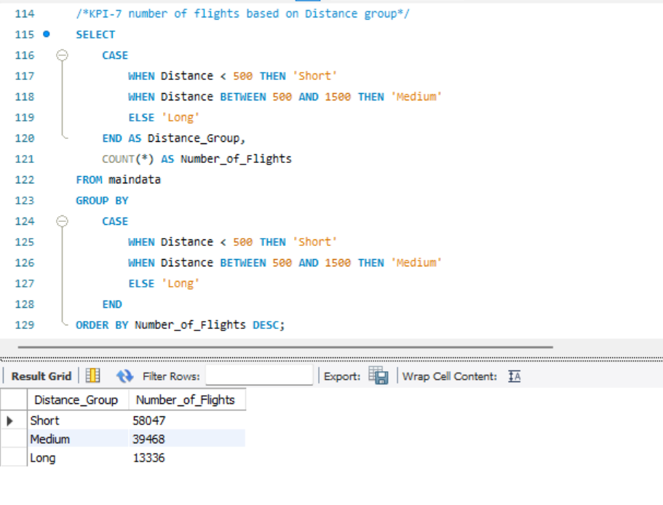
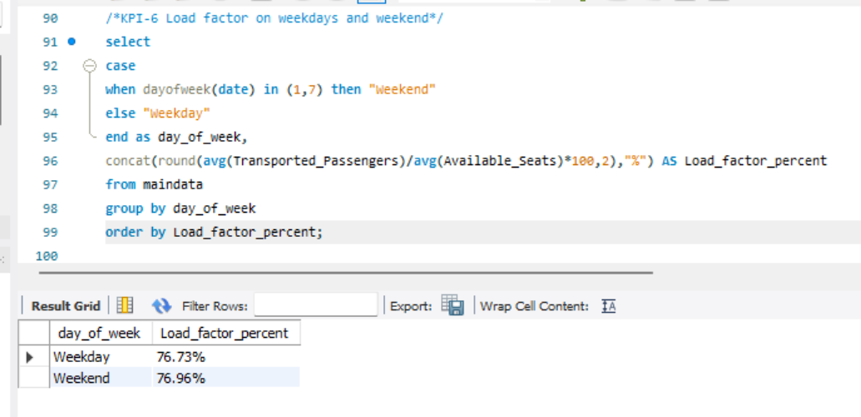

Slide 17
RECOMMENDATIONS
Optimize Flight Routes: Utilize insights from up routes and flights to Optimize schedule and resource allocation. Optimize weekend flights to increase load factor.
Enhance Load Factor: Leverage load factor analysis to identify trends and implement strategies for increased efficiency. Increase flights on popular routes like Chicago to New York.
Strategic Carrier Partnership: Collaborate with top carriers to maximize passenger transportation and enhance overall performance. Focus marketing on underperforming routes.
Resource Allocation: Allocate resources strategically based on flight schedules and passenger volume data. This ensures efficient operation and minimizes wait times at airports with high passenger traffic .

Slide 18
Conclusion
High Cloud Airlines empowers the aviation industry with actionable insights, foresting efficiency, and strategic decision–making. The presented KPIs offer a glimpse into the vast potential for improvement and growth within the industry. By harnessing the power of data, we can drive positive changes, ensuring a bright future for High Cloud Airlines and its partners in the aviation sector .
Excel was used for data preparation.
Tableau provided initial visual insights.
Power BI created an interactive dashboard to dive deeper.
A combination of tools gives the best outcome.

Slide 19
Thank You…

